Slide 1




DreamForge Turn Your Concepts into Projects
Supervisor: Alex Keselman
Presenters: Or Yosef & Yaniv Lippa

Slide 2


Overview
01
04
Introduction
The Product
02
05
The Problem
Verification
03
06
Our Solution
Challenges

Slide 3

Introduction
In this area, more and more people are using AI features to simplify their lives across various fields.
We aim to enhance the capability of ambitious individuals to formalize their ideas into project books using AI.
The main goal is to create a fully functional website where users of any background can easily create books by simply entering their project ideas.

Slide 4




The problem:
Transforming an idea into a comprehensive project book using AI is not straightforward and often involves complex steps that can be intimidating.
Utilizing advanced AI tools for documentation generation can be expensive, limiting access for individuals or small organizations.
Many AI tools require specific technical skills or detailed input to produce meaningful results, creating a barrier for those with less experience.

Slide 5

Existing solutions
Today's AI features for project management and documentation offer some capabilities but each come with its own limitations:
ChatGPT-4: Facilitates book creation through structured conversation.
Requires detailed, step-by-step input, which extends the time needed to
create content.
ClickUp : user-friendly, allows workflow customization.
Requires time to adept and it is limited to integrate with other tools.
Scribe – excels in automated documentation, supports integration with other platforms.
Lacks the ability of capturing every detail needed for a more complex documentation.

Slide 6




Our solution
DreamForge is a website Ai application which allows any user with any level of experience to transfer his idea into a project book by entering their idea.
We will offer a convenient and simple user interface, where a user can enter his idea in the simplest way. If he is interested, he can also specify the programing languages or technologies he would like to work with and if not mentioned, it will be chosen automatically.
Users will be able to create a project book, view their generated book online, also download and manage each of the user’s project from the user's personal library.

Slide 7
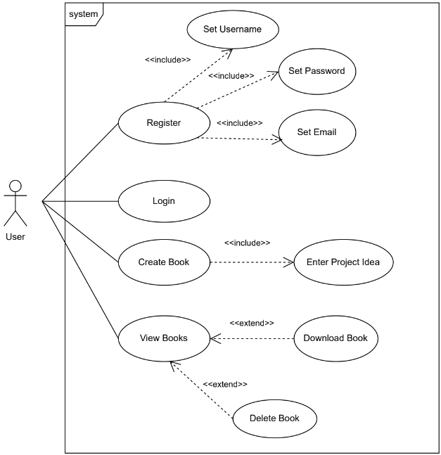

The Product
Use Case diagram:

Slide 8
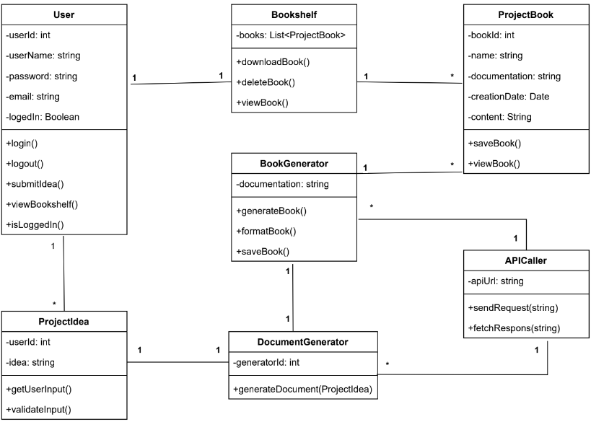
The Product
Class diagram:

Slide 9
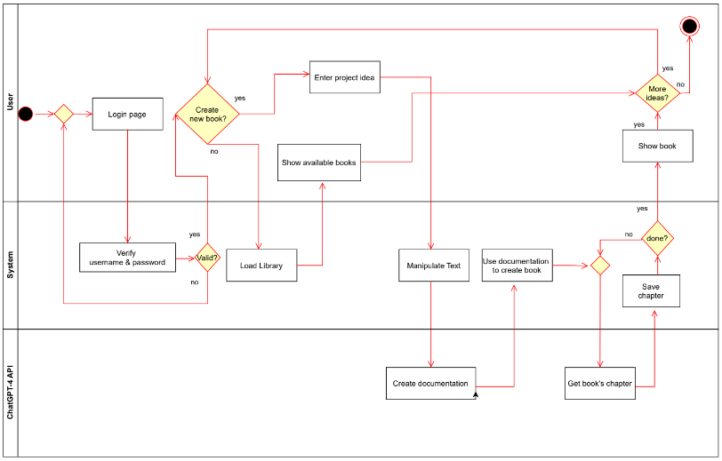
The Product
Activity diagram:

Slide 10








The Product
Architecture
API
Request content
generation
Returns generated
content
Sends user input
Stores project data
Display project data
Retrieves project data
Web
Server
Database

Slide 11



The Product
Complete Project Book
Prompt wrapping
Prompt wrapping
One chapter of the book
One chapter of the book
Documentation File
Last chapter of the book
Idea
Next chapter
Next chapter

Slide 12
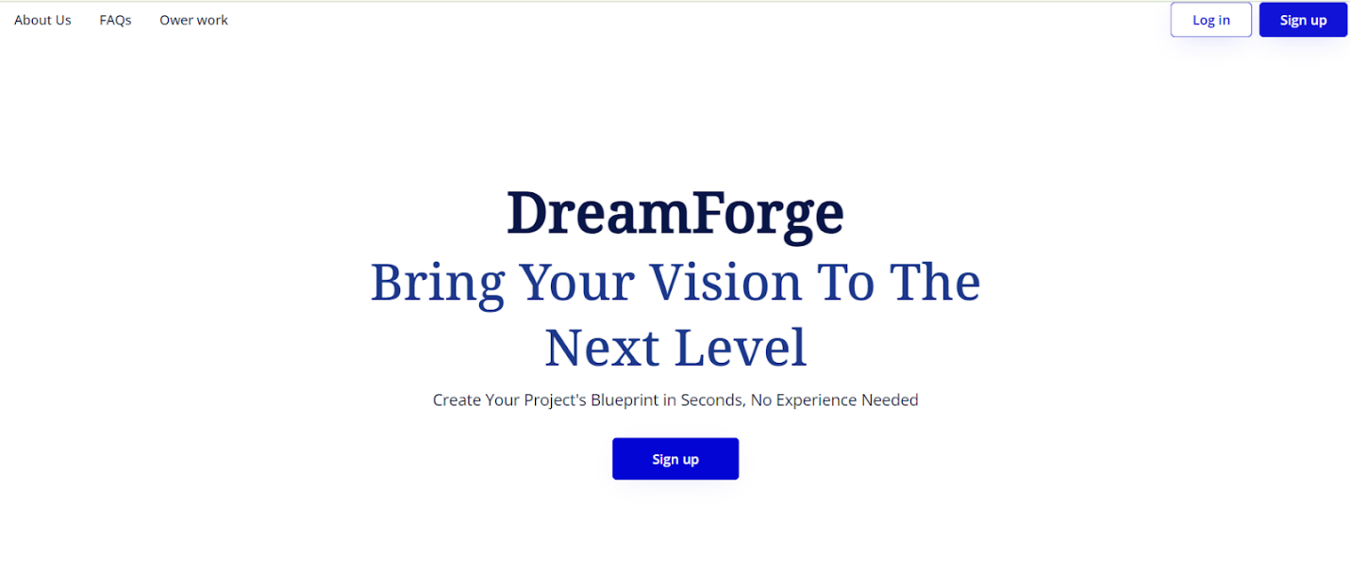
The Product
User interface
Home page:

Slide 13
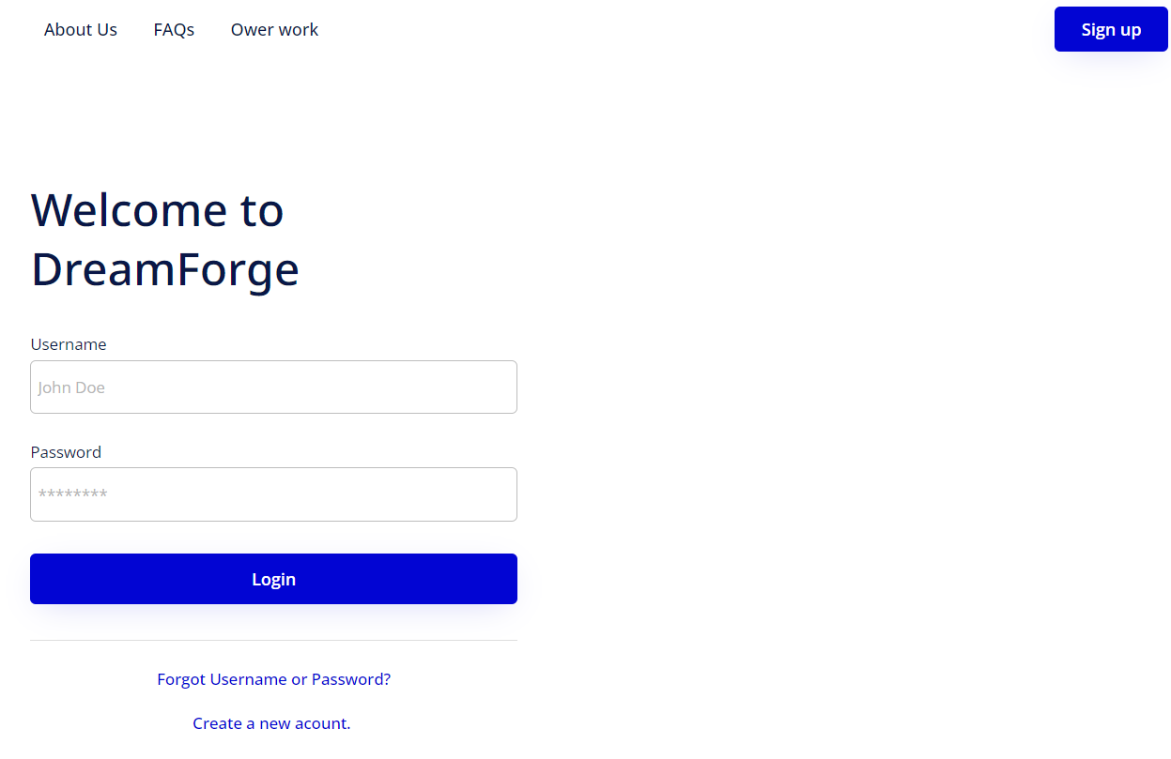

The Product
Login page:
User interface

Slide 14
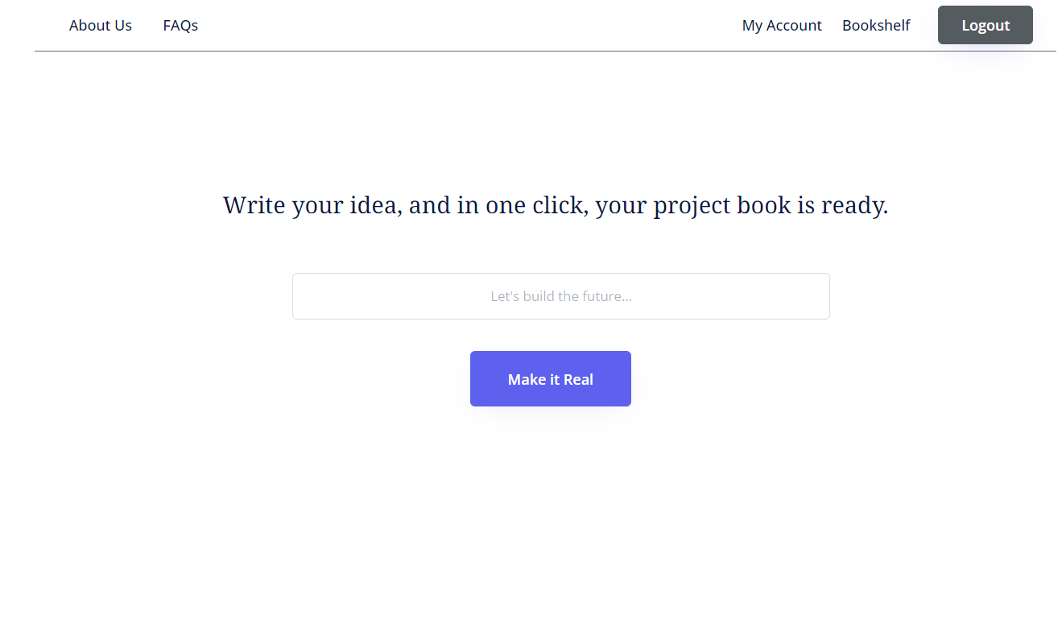
The Product
User interface
Idea submission page:

Slide 15
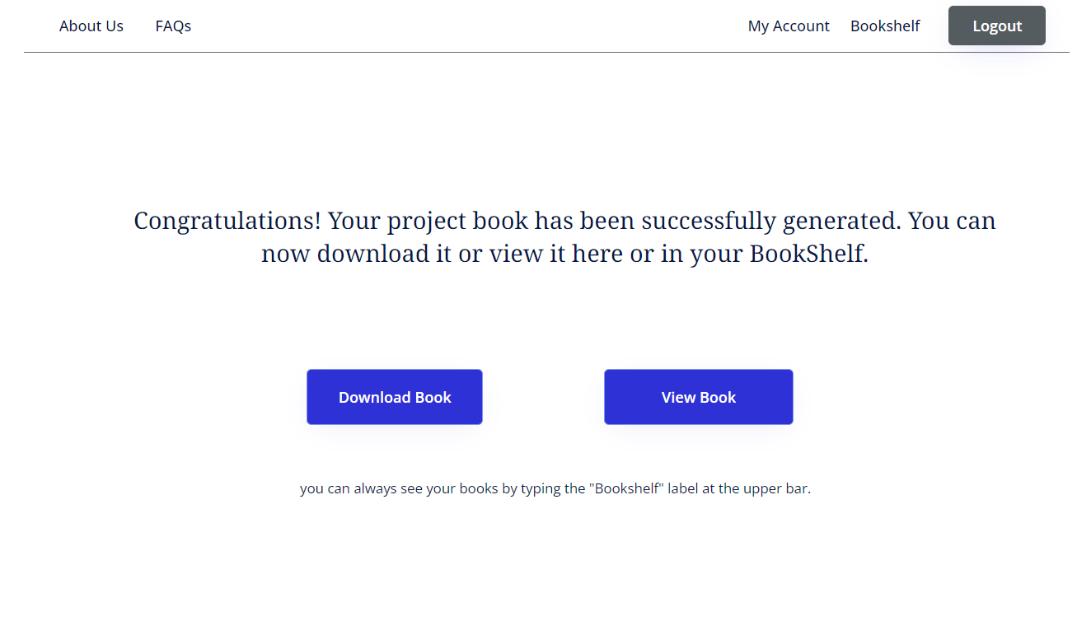
The Product
User interface
Book created page:

Slide 16
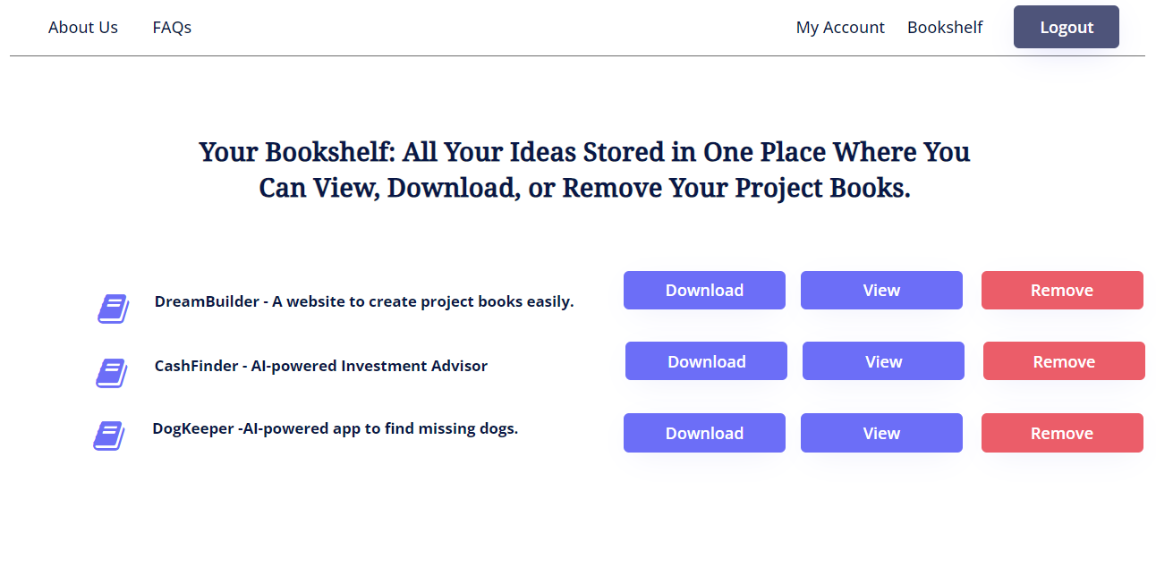
The Product
User interface
Personal bookshelf page:

Slide 17

Verification
Unit-testing
Expected result | Test Subject
Message: “Invalided email address” | Registration - Enter invalid email | 1
Message: “Invalid character used” | Registration – Invalid character entered | 2
Message: “This username already exists” | Registration – Enter already existing username | 3
Message: “Wrong username or password” | Login – Enter wrong username/password | 4
Message: “This user is currently logged-in” | Login – Enter an already logged-in user details | 5
Message: “Must enter username and password” | Login – Login with empty username or password | 6
Message: “Idea must be more then four words” | Idea submission – Enter idea with less then four words | 7
Message : “Could not understand your idea” | Idea submission - Meaningless idea entered | 8
Message : “Warning – your idea may be offensive” | Idea submission - Offensive text entered | 9

Slide 18
Verification
Functional-testing
Expected Result | Test Subject
The screen will switch to the “Idea submission” page | Login – Enter valid user details and press “Login” button | 1
The screen will switch to the “Book created” page | Idea submission – Enter a valid idea and press the “Make It Real” button | 2
The project book will be downloaded to the user’s computer | Book created - press the “Download Book” button | 3
The created book will be shown on the screen | Book created - press the “View Book” button | 4
A warning message window will appear: “Are you sure you want to remove the book?” | Bookshelf - press “Remove” button for specific book | 5
The book will be removed from the bookshelf | Bookshelf (warning) - press “Yes” button after warning appear | 6
The screen will return to the original bookshelf screen | Bookshelf (warning) - press “No” button after warning appear | 7
The chosen book will be shown on the screen | Bookshelf - press the “ View” button for a specific book | 8
The chosen book will be downloaded to the user’s computer | Bookshelf - press the “ Download” button for a specific book | 9

Slide 19

Challenges
The use of the ChatGPT-4 API is different from the regular use of the chat. We need to understand the terms and make accurate calls.
User input is unpredictable. We must accurately process the provided text to ensure the most precise project book.
The cost of the process can be significant. We need to ensure accuracy in trial runs to avoid excessive costs.

Slide 20

Thank you
For listening
Any Questions?

